Slide 1
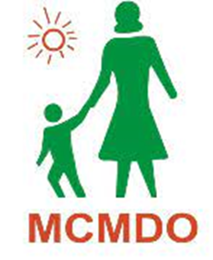
Closing Event: Participatory Forum on Protracted Displacement in an Urban World
Kabul
November 8, 2023
Notes:
Main heading: Raleway Bold - size 60 - white
Subheading: Raleway Regular - caps lock - size 24 - white

Slide 2
EVENT AGENDA
Activity | Time | Lead
Welcoming and Opening Remarks | 9:35 – 9:45 | UNHCR
City note & Data presentation | 9:45 – 10:30 | Samuel Hall
Tea Break | 10:30 – 10:45
Panel Discussion: Reflections on the Participatory forum process with participants from Jalalabad from Participatory forum | 10.45 - 11.45 | Jalalabad PF representatives
Questions & Answers from attendees | 11.45 - 12.30 | All
Lunch | 12:35 – 13:30 | All
Notes:
GCRF: Support cutting-edge research that addresses the challenges faced by developing countries
Long project, multiple phases
How the consortium works in practice

Slide 3
WHY THIS PROJECT?
DISPLACEMENT IN CAMPS VS DISPLACEMENT IN URBAN AREAS
For decades, the response to mass movements of people fleeing war or political persecution has been to provide humanitarian assistance in camps or settlements leading to situations of protracted displacement with no solutions in sight.
Camps are not the choice of the majority of the world's displaced people, and estimates suggest that over 60% of refugees and half of internally displaced persons (IDPs) now live in towns and cities.
Research, international policy discourse and local action have been slow to catch up to understanding camp versus urban displacement. The research is the first large-scale study to compare experiences of displacement in cities and camps and provide evidence analysis of the outcomes for displaced people in these different settings.
Notes:
Despite contentious debates on the negative impact of maintaining forcibly displaced people in often inhospitable and remote regions and dependent on humanitarian assistance, camps have continued to be a default response to new crises.
Dadaab Camp & Urban Nairobi, both in Kenya

Slide 4
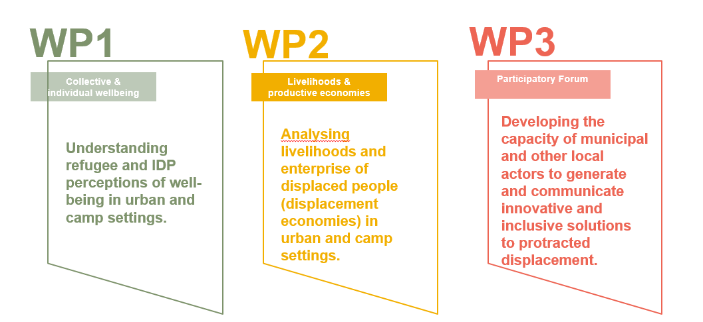
A LANDMARK STUDY ON DISPLACEMENT
Out of camp or out of sight? Realigning responses to protracted displacement in an urban world
The research is being conducted by a global consortium - academics joining their research to practice.
10 partners
4 countries: Afghanistan, Ethiopia, Kenya, Jordan
3 work packages.
Notes:
GCRF: Support cutting-edge research that addresses the challenges faced by developing countries
Long project, multiple phases
How the consortium works in practice

Slide 5
OBJECTIVES
ASSESS
current responses to urban protracted displacement
Connecting the Dots
IMPROVE
Well-being & livelihoods of displaced people; participation in urban life & contribution to host cities.
EVIDENCE
Build an evidence base on hosting displaced people in camps vs. urban areas: quality of life, well-being, hopes for the future
Host Communities
Returnees
IDPs
DfA
To work with you to
Donors
Civil society
CAPACITY
Involve municipal actors in the research process, build capacities for using evidence to inform solutions to displacement.
UNDERSTAND
The differences between urban and camp displacement experiences + who is better off in these settings
International Organisations
Notes:
Evidence: to support international policy and decision-making on innovative solutions to protracted displacement
Assess: the unmet needs & potential socio-economic contributions of displaced. An assessment of how an urban response can support a rights-based approach to local integration
Capacity: Build the capacity of municipal authorities, displaced people, organisations of the urban poor and other local actors to use participatory planning to develop innovative, inclusive solutions to forced displacement.
Through partnership with displaced and host populations, and collaborations between international experts, operational actors, developing-country academics, local NGOs and affected communities.
Guidance for municipal governments facing large influxes of people.
What are the displacement experiences comparing displaced people living in camps/settlements with displaced people living in urban settings?
Who is better off / better able to achieve economic self-reliance?
What are the different perceptions of quality of life: Including access to income-generating activities, health, education and shelter, but also focusing on less-tangible indicators linked to well-being such as hope for the future?

Slide 6
CONTENTS
THE PARTICIPATORY FORUM PROCESS
THE DATA -
WELLBEING, LIVELIHOODS, WOMEN
PROJECTS & DISCUSSION
Notes:
Heading: Raleway Bold size 28 - white - always capslock
Text in circles: Raleway Bold size 18 - always capslock & centered
Background colour: #536f88ff

Slide 7
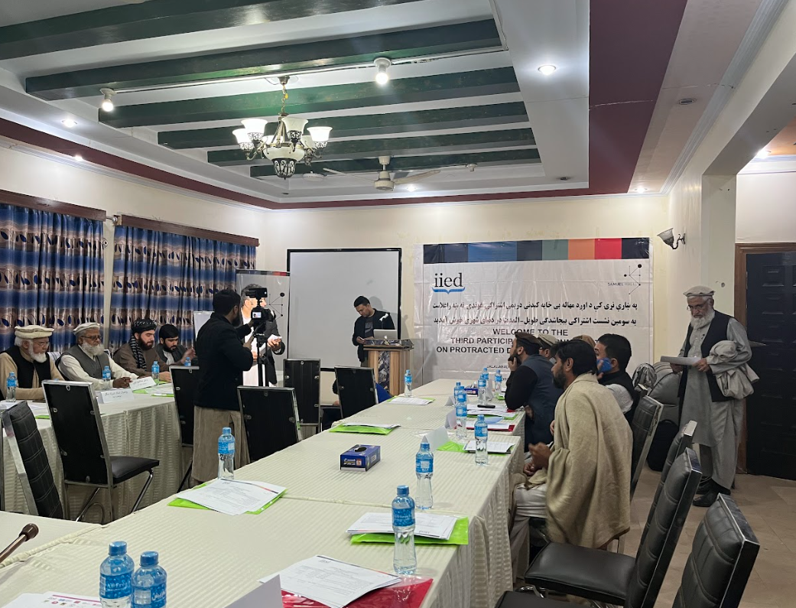
Jalalabad City Note: Urban solutions for local integration
The city note is the consensus document that emerged from the three-year participatory forum process in Jalalabad city, with municipal stakeholders, including municipality representatives, De facto Authorities, civil society and IDP representatives as well as International Organisations.
During the process, representatives set disagreements aside to focus on a consensus approach to city planning with displaced communities.
Five participatory forum sessions were held in total between February 2021 and July 2023.
The final city note was validated at the July 2023 participatory forum by all participants.
Livelihoods
Third participatory forum in Jalalabad, 27 November, 2022.
Notes:
*Pause when presenting - does the audience have any questions on what they have seen so far?*
Raleway (bold) size 40. Always capslock.
Break page - before the start of the next section of the presentation.
Overlay the image with a transparent shape so that you can easily read the white text and see the white SH design at the corners.
Always ensure that the image follows safeguarding policy and that you have explicit permission to use it.
Unsplash.com is a good resource for free images

Slide 8
Consensus 1: Rethinking aid and social inclusion
At a time of widespread need
Participants called for re-envisioning the city as a space of inclusion for the IDPs and women. This involves creating and supporting livelihood opportunities for women, including work from home, and engaging both IDPs and women in the decision making process on aid distribution.
The municipality was asked to set aside one day a week to listen to women, and to welcome IDP and other female community representatives to the municipality for consultations.
The is a need to include civil society organisations in decisions on aid distribution.
Women should be provided with opportunities to work from home, including by providing equipment to practice their skills; while also opening opportunities for them to work on agricultural lands close to the city.
Notes:
Despite contentious debates on the negative impact of maintaining forcibly displaced people in often inhospitable and remote regions and dependent on humanitarian assistance, camps have continued to be a default response to new crises.
Dadaab Camp & Urban Nairobi, both in Kenya

Slide 9
Consensus 2: Enhancing urban planning starting with:
A greener city and dedicated spaces for youth and women
There are tensions between the municipality and the residents, and a lack of space to meet and plan together - which the PF helped fill. All participants emphasised the need to include the displaced in city planning, and the municipality on the need to support its capacity to develop….
A city strategic plan that that can address the needs of the hosts and the displaced.
City expansion plans are urgently needed as Jalalabad is overpopulated and informal settlements require upgrading. All municipal stakeholders agreed that the issue of a greener and cleaner city is among the first priorities for integration and inclusionin the city.
There is a need to identify new places for IDPs to reside, new spaces for organisations to deliver assistance, and for children, youth and women to have a place to spend time and feel safe in.
Notes:
Despite contentious debates on the negative impact of maintaining forcibly displaced people in often inhospitable and remote regions and dependent on humanitarian assistance, camps have continued to be a default response to new crises.
Dadaab Camp & Urban Nairobi, both in Kenya

Slide 10
Consensus 3: Enabling local integration
Through access to legal documentation and legal services in displacement
After decades spent in displacement in Jalalabad, IDPs demand a pathway for local integration. Despite being registered as IDPs, living in Jalalabad, they live in settlements where they do not own land or a house in their own names.
Participants called for the provision of access to legal documentation, civil registration and business licences for IDPs. Women who used to be able to travel for work are no longer able to, either due to the restrictions on movement or their inability to renew their passports.
There is a need for the provision of legal services regarding issues related to child and forced marriages as well as child labour, and more safety and security for women in relation to sexual harassment.
There is no job market for women – no factories or opportunities for them to work. Factories for food processing, and basic goods could be established to enable new stable sources of income, and to provide a space for women to work.
Notes:
Despite contentious debates on the negative impact of maintaining forcibly displaced people in often inhospitable and remote regions and dependent on humanitarian assistance, camps have continued to be a default response to new crises.
Dadaab Camp & Urban Nairobi, both in Kenya

Slide 11
CONTENTS
THE PARTICIPATORY FORUM PROCESS
THE DATA -
WELLBEING, LIVELIHOODS, WOMEN
PROJECTS & DISCUSSION
Notes:
Heading: Raleway Bold size 28 - white - always capslock
Text in circles: Raleway Bold size 18 - always capslock & centered
Background colour: #536f88ff

Slide 12
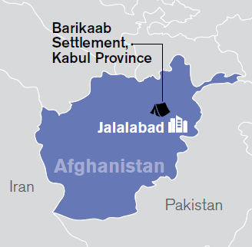
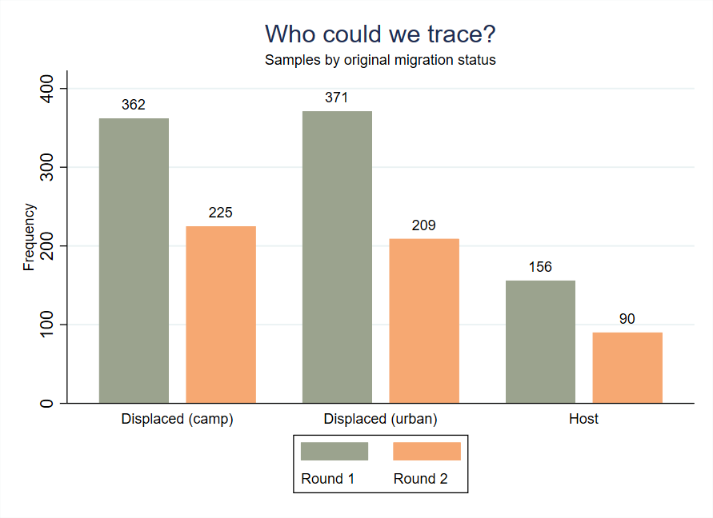
SURVEY SAMPLING
Global surveys:
3,480 surveys across four countries and eight research locations with displaced people and urban hosts
Afghanistan surveys:
360 displaced surveys in Barikab
360 displaced surveys & 150 host surveys in Majbor Abad, Jalalabad
We conducted two rounds of data collection, in Barikab, Kabul and Majboor Abad, Jalalabad.
The first round in Feb/March 2021,
The second round in August 2022, targeting the same respondents to compare their livelihoods and wellbeing situation, before and after the regime change.
 | Barikab settlement | Majboor Abad
 | Displaced | Displaced | Hosts
Round 1 | 362 | 371 | 156
Round 2 | 225 | 209 | 90

Slide 13
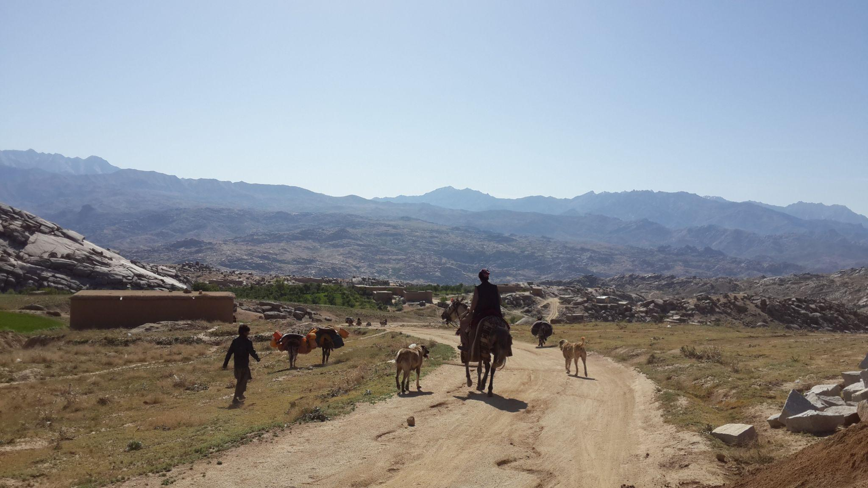
Livelihoods
Livelihoods
Notes:
*Pause when presenting - does the audience have any questions on what they have seen so far?*
Raleway (bold) size 40. Always capslock.
Break page - before the start of the next section of the presentation.
Overlay the image with a transparent shape so that you can easily read the white text and see the white SH design at the corners.
Always ensure that the image follows safeguarding policy and that you have explicit permission to use it.
Unsplash.com is a good resource for free images

Slide 14
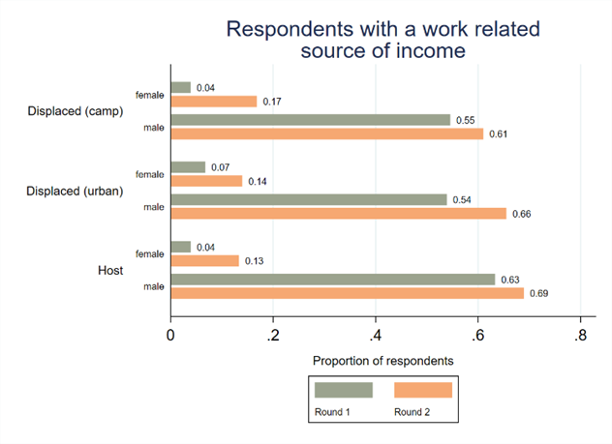
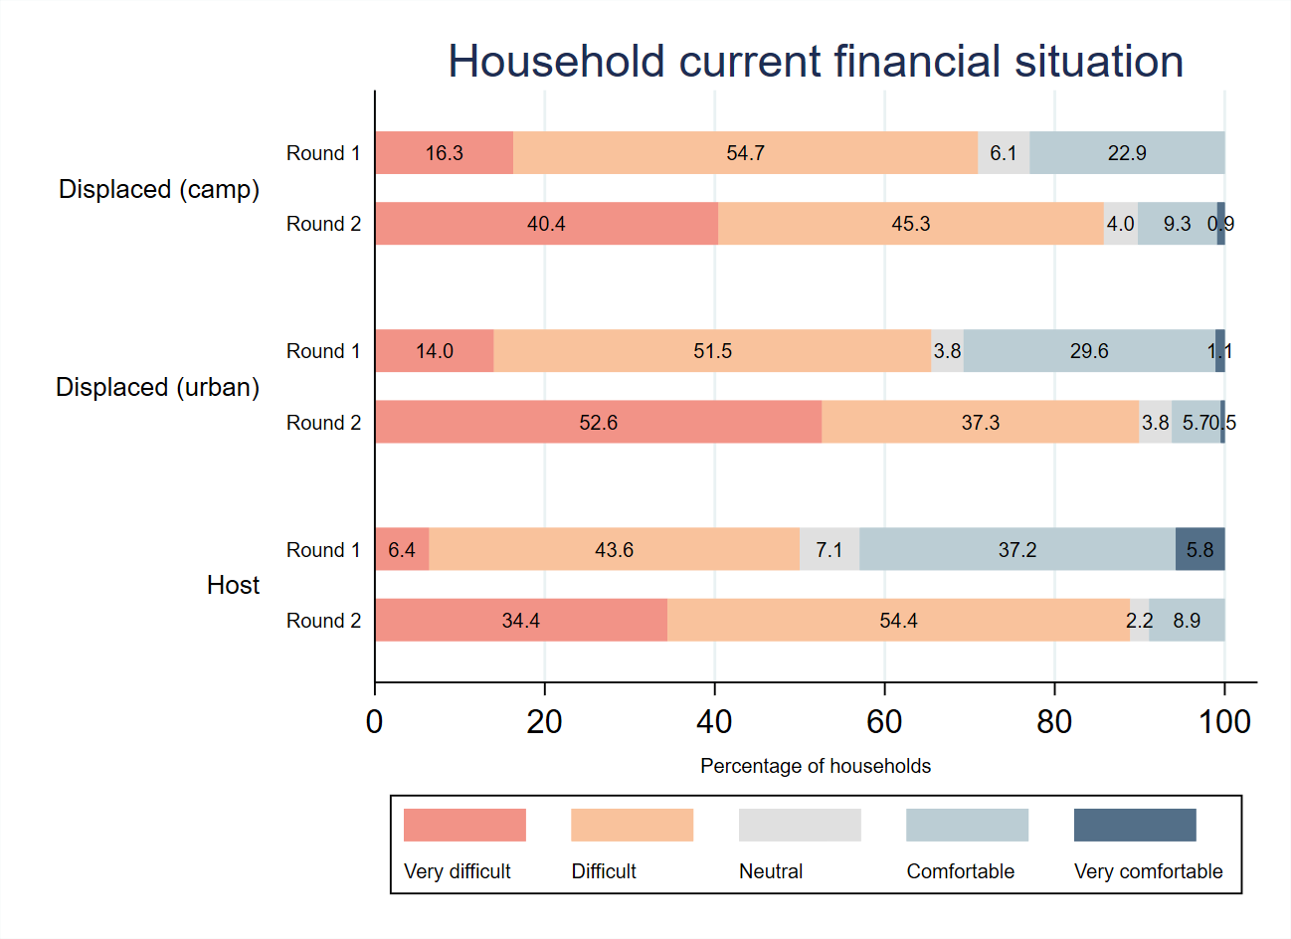
MORE ARE WORKING, SIMPLY TO SURVIVE
Both men and women were working more in 2022 compared to early 2021.
The overall household monthly income was lower during the second round.
Overall financial situation of households has worsened between 2021 and 2022.
‘If people’s situation does not get better, we will lose all my investment. People do not have money and ask for goods on credit. If you do not give credit, you cannot run a shop here’.
(Male IDP/R entrepreneur, 34)
Notes:
both men and women were working more in mid- 2022 compared to early 2021. However, this increase in work is primarily driven by the necessity to generate additional income in response to the dire economic situation faced by the surveyed population .
Among urban displaced individuals: the percentage of respondents reporting a very difficult financial situation increased from 14% in the earlier period to a striking 53% in 2022.
As consumers are poor, all those selling suffer - customers cannot pay back debt.

Slide 15
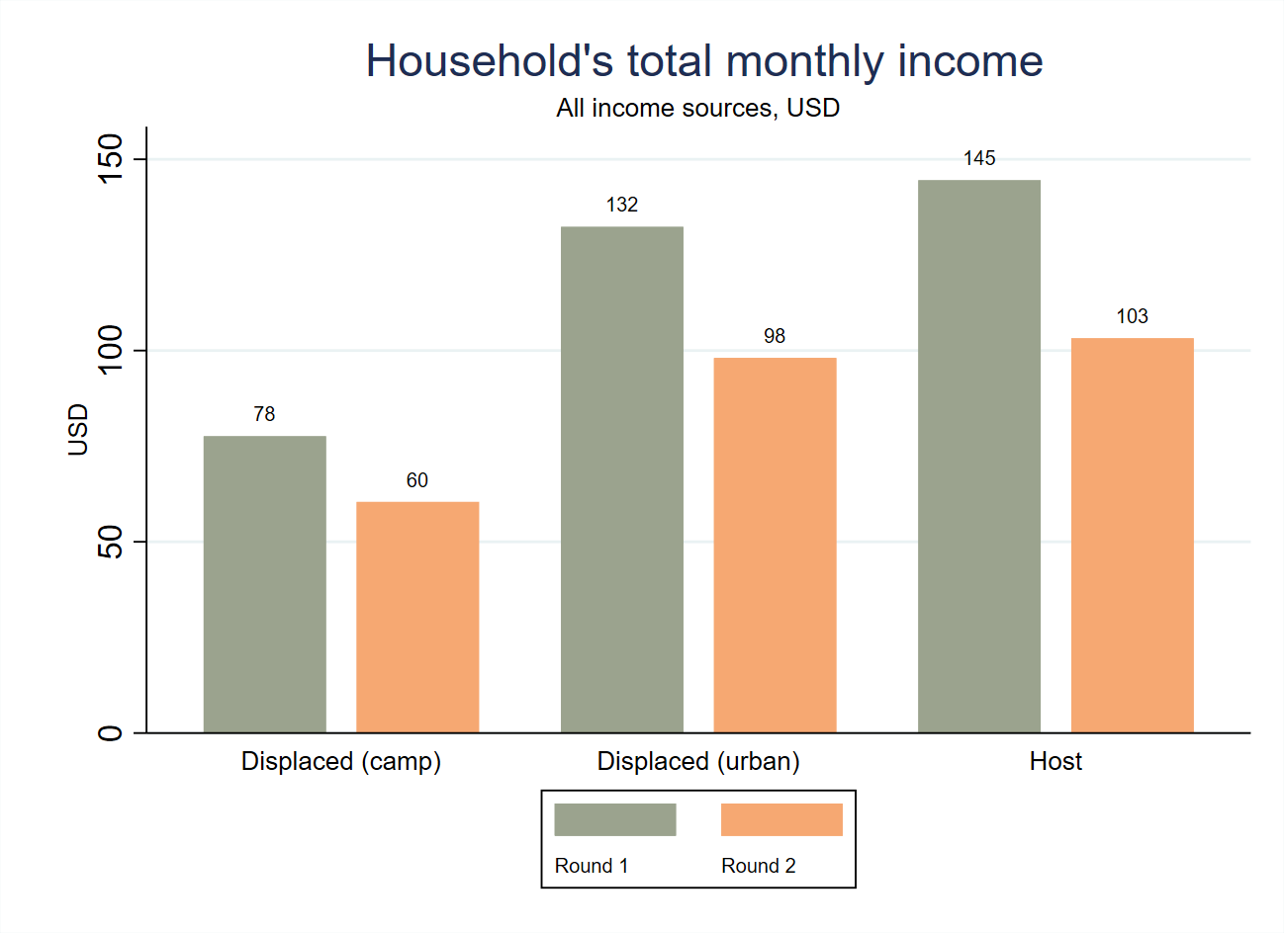
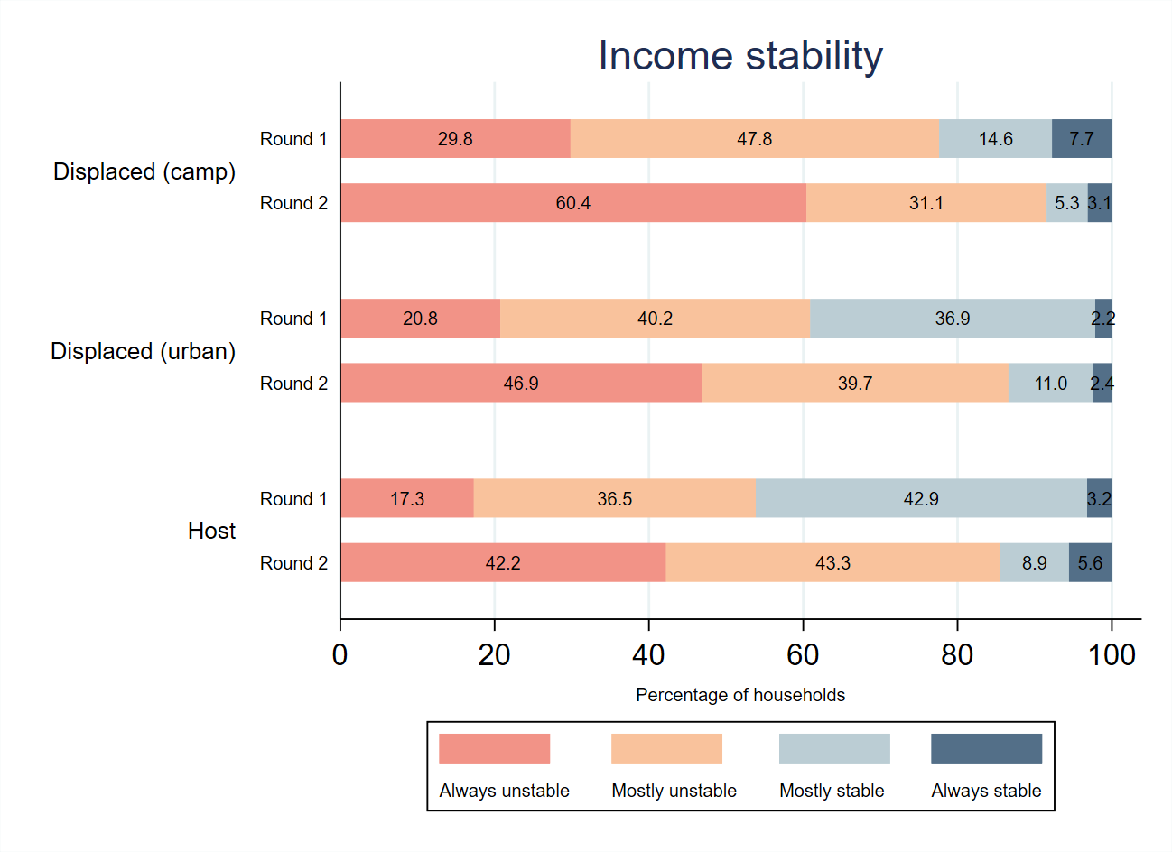
REDUCED AND UNSTABLE INCOME, MORE DANGEROUS JOBS
Fewer people can cover expenses with income from work: only 7% of displaced individuals and 12% of hosts state that their income from work is sufficient to cover their household expenses.
More consider their work is not adequately remunerated.
Their income is mostly or always unstable
Working conditions are rated more unsafe.
‘The bad economic situation impacted us negatively; we can’t afford daily expenses and we have no choice to deal with this problem because there are no opportunities’.
(Female IDP in Barikab)
Notes:
Meanwhile, finding work in the city is difficult, and work satisfaction has decreased. While hosts surveyed in ‘round one’ reported that they were in a somewhat better financial position than the urban displaced, such differences seem to have decreased since then, and both groups are in similarly dire financial positions.
And while people report working more to face a challenging economic situation, the data shows that it might not be enough: less people are likely in round 2 to report being able to cover their household expenses with income from work than in round 1. The situation is particularly alarming in the city, where only 7% of displaced and 12% of hosts report being able to cover expenses with income from work in round 2.
When asked about how satisfied respondents were in their work, we see that in Majboor Abad among both displaced and hosts, there is a considerable increase in those who report dissatisfaction at work in the second round of data collection, with 34% of urban displaced and 24% of hosts being somewhat or very dissatisfied with their jobs. more people are likely to report unsafe working conditions in round 2. The increase is particularly marked among displaced urban. There is a general sense among respondents in the second round of data collection that their work is not being remunerated adequately: 65% of urban displaced and 68% of hosts think that they are not being paid fairly in August 2022, compared to only 18% of urban displaced and 15% of hosts in February/March 2021.
Data on the self-reported household financial situation shows that, while the overall financial situation of most households was already concerning in February/March 2021, it deteriorated even further in August 2022: among urban displaced, 53% report a very difficult financial situation in 2022 compared to only 14% in February/March 2021.
·

Slide 16
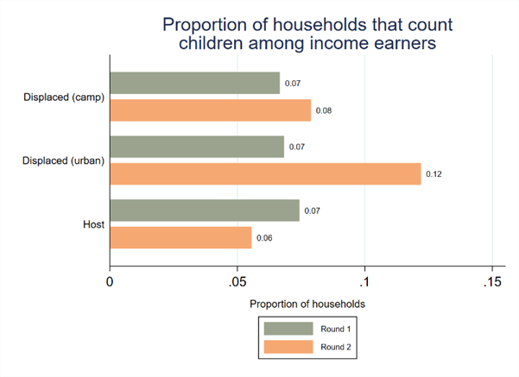
CHILD LABOUR HAS BECOME MORE COMMON, WHILE WOMEN ARE EAGER TO WORK
More children among the income earners, particularly among the urban displaced (12%) and particularly among female-headed households.
‘I bake popcorn and snacks and sell them with chew gums, and boiled eggs in a small shop located inside my house in Majboorabad. At the beginning, when I started selling popcorn, my kids could not sell all of the products and some would remain unsold. I would re-send my kids to the streets to sell them all tomorrow. The community children call them names and insult them. The other children snatch the products from their hands’.
(Female IDP in Majborabad, 30)
Urban displaced women are among the non-working respondents who showed the greatest desire to work.
Notes:
Mechanically, earner ratios increased among the target population. Not all of these additional earners were adults: the data reveals a trend where more households were relying on children as income earners as a coping strategy to address the economic challenges they face
This trend was particularly pronounced among displaced urban households, where 12% of households reported counting children among their income earners in August 2022.
In some cases, children engaged in work for a few hours after school, while in more financially constrained families , children may be were dedicated to work full-time. Women often utilized their children's help to sell their products outside of their homes. This may involve children accompanying their mothers and assisting with marketing and sales activities. Additionally, minors may be paid for performing small tasks in workshops and other businesses. For instance, they may help rickshaw drivers by attracting customers
There has been an increase in wanting to work among displaced women – from 72% in 2021 to 82% in 2022.

Slide 17
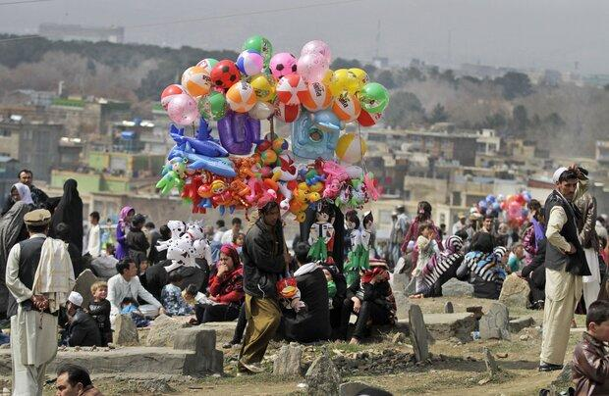
Well-being
Wellbeing
Notes:
*Pause when presenting - does the audience have any questions on what they have seen so far?*
Raleway (bold) size 40. Always capslock.
Break page - before the start of the next section of the presentation.
Overlay the image with a transparent shape so that you can easily read the white text and see the white SH design at the corners.
Always ensure that the image follows safeguarding policy and that you have explicit permission to use it.
Unsplash.com is a good resource for free images

Slide 18
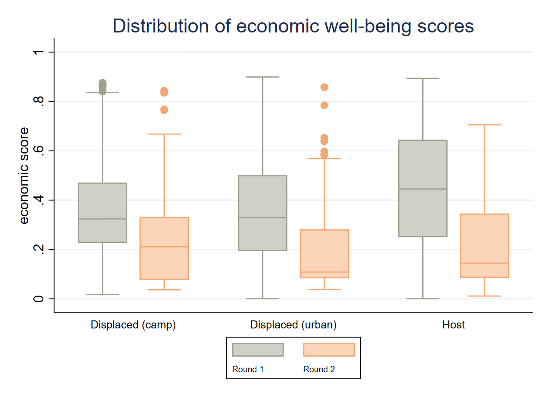
ECONOMIC WELL- BEING
Economic well-being : comfortable financial situation, stable and predictable income, being able to cover one’s expenses with income from work, having savings, being able to borrow.
Generalised and drastic deterioration across all groups:
Lower income stability
Lower incomes
More difficulty covering expenses from work
Lessened ability to borrow
‘There is no bigger concern than poverty. Poverty and lack of access to jobs have become great suffering for me. Most of the time, my children cry over food, I burst into tears when I see my kids crying and not having enough food to eat. Whenever I experience such a thing, I complain to God about why he has only made us face such poverty.’ (Female IDP in Barikab, 22)
Notes:
The first thing to note is that our data shows clear evidence of a generalized deteriorating financial situation. Indeed, across all populations, respondents report on average a more difficult situation in round 2 than they did in round 1: 53% of the urban displaced report in round 2 a very difficult situation, against only 14% in round 1.
Similarly we can observe a clear decrease in reported stability of the household’s income: 60% of camp displaced report an always unstable income in round 2, against only 30% in round 1.
This deterioration of the financial conditions of the household, of course impacts the ability to cover needed household expenses with the existing sources of income.
At the same time, their ability to borrow when needed has also substantially decreased. Leaving them with no options to cover basic needs expenses.

Slide 19
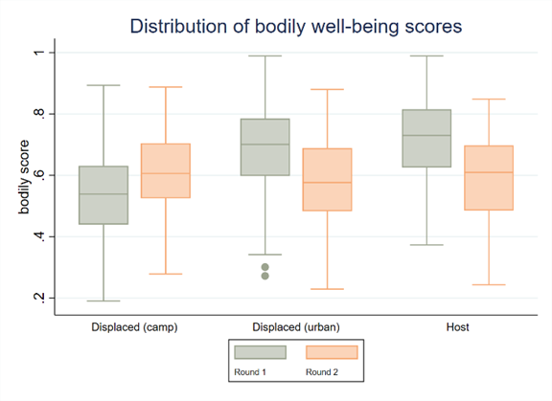
BODILY WELL-BEING
Bodily well-being: access to water, sanitation, healthcare, and pharmacies; respondents’ own rating of their general health, housing situation, quality of healthcare in the area, perceptions of safety, food security.
Decrease in self-reported state of health esp among the displaced.
Healthcare affordability and accessibility are a major concern.
90% struggle to feed their families. The situation is particularly dire in the city.
Large & concerning debts being accumulated for those who rent.
People feel less safe.
‘Poverty has negatively affected us and due to its negative impact, I developed thyroid sickness and one of my daughters has hepatitis B and her sickness has increased due to eating less food. I cannot take her to the doctors as they say she should eat good foods, but I cannot afford to provide her with bread’. (Female IDP in Majboorabad, 50)
Notes:
Bodily wellbeing of interviewed camp dwellers in Afghanistan was lower than that of their urban peers in early 2021, but this changed by the summer of 2022.
decreasing quality of infrastructure (electricity, water access) · Access to the most basic services and key city infrastructure has worsened for both urban displaced and hosts. There have been substantial decreases in reported access to healthcare and health-related services for both urban displaced and hosts. Another stark fall can be observed in reported access to a community space or a sports centre.
Perceived safety has decreased in Jalalabad, particularly for women. In 2021 only 9% reported not feeling safe. By 2022 the percentage had risen to 30%.

Slide 20
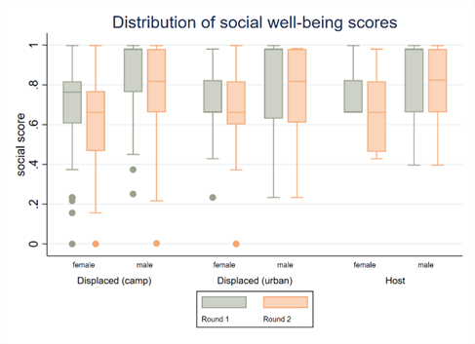
SOCIAL WELL-BEING
Social well-being: ability to spend time with friends and family, access space to socialise, getting along, a network.
The drop in social well-being scores is more significant for women.
Decrease in satisfaction with social interactions, particularly for women.
A notable decline was observed in the availability of someone to turn to in case of danger or need for help.
Isolation impacts adults, especially women, but also children: The proportion of families unable to access schooling has almost tripled for the displaced and quadrupled for hosts.
‘I love visiting my close relatives and families such as my mother and father who are living in the city, I am not able to meet them soon or anytime and can’t go to their house because the cost of transportation from here to their house is so high and I can’t afford it’.
(Female IDP in Barikab)
Notes:
Traditionally, social networks and opportunities for social interaction have been seen as advantages of living in urban areas.
A notable decline was observed in the availability of someone to turn to in case of danger or need for help. The proportion of women reporting not having someone to rely on in such situations increaseds to 16%, compared to only 3% in the first round.
This suggests that the decline in social well-beingwellbeing has a disproportionate impact on women[BM1] , potentially reflecting increased barriers to social engagement, decreased access to social resources, or a heightened sense of exclusion and isolation.
Social isolation also extends to children, especially girls but not only: The proportion of families unable to access schooling has almost tripled for the displaced – from 10% in 2021 to 26% in 2022, and even more so for hosts – from 4% in 2021 to 25% in 2022.

Slide 21
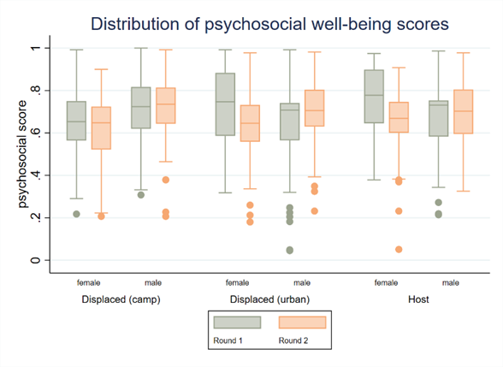
PSYCHOSOCIAL WELL-BEING
Psychosocial well-being : life satisfaction, feeling at home, optimism, feelings of independence and agency and being treated with respect.
Respondents are less satisfied with their lives in 2022, especially the displaced.
Increase among those who feel they do not use their time productively, particularly in Barikab. Nothing to alleviate sense of boredom and lack of purpose.
After initial hope / optimism in round 1, now widespread belief in round 2 that children’s future will be worse.
Notes:
The shifts are visible but they do not look massive … this is deceiving!
Part of the explanation for the lack of seismic shift in overall scores may well lie in the already dire situation in 2021:
The people’s mental health was not good during the Republic government because there were a lot of killings. Every alley would receive dead bodies. Many young men would return wounded and some of them would even come back without hands, feet, or eyes. I saw it even among my relatives. My paternal cousin was martyred, and it impacted us so badly. (Male IDP in Jalalabad, 38)
Additionally, in Afghan culture, it is not always easy for individuals to openly discuss their worries and concerns. This cultural tendency towards restraint and resilience may reflect in the relatively positive survey responses obtained during the data collection process . It is possible that individuals may hesitate to fully disclose their anxieties and struggles in the survey format

Slide 22
Women
Gender

Slide 23
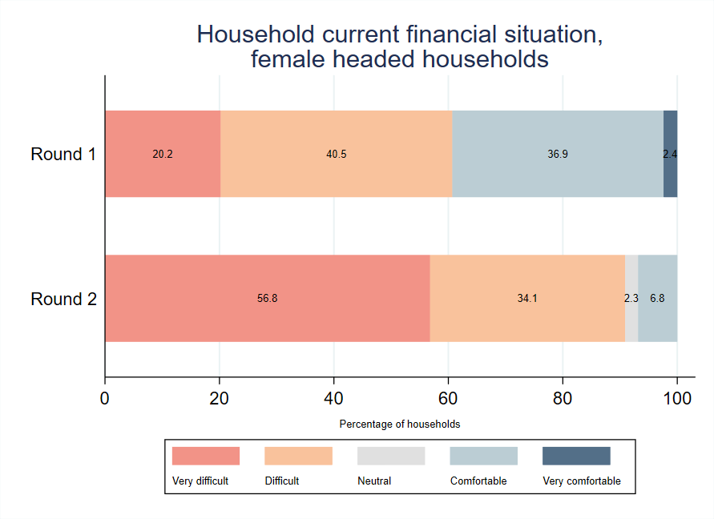
THE ROLLING BACK OF A SUCCESS STORY
Female-headed households face a grave deterioration in circumstance between the two rounds.
They make less money (lower monthly income), have lower income stability, have a worse-off financial situation and are much less likely to be able to cover their household expenses through income from work.
This means that they will rely more on borrowing, but the ability to borrow has also decreased : 78% of FHH reported being able to borrow money if needed in round 1, this number dropped to only 36% in round 2.
Notes:
Child work is present in both locations, ranging from a few hours after school to full dedication in poorer families. Women often make use of their children to sell their products outside of their home, and minors are also paid for small tasks in workshops and other businesses, like getting customers for rickshaw drivers.

Slide 24
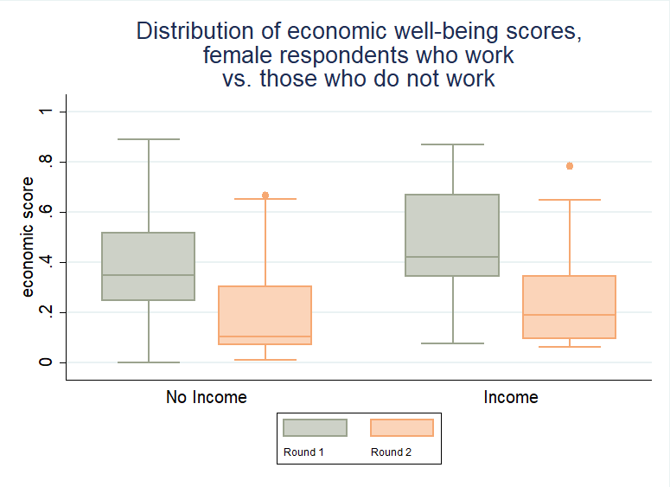
HAVING A LIVELIHOOD IS ECONOMICALLY AND SOCIALLY BENEFICIAL FOR WOMEN
‘It has lots of social benefits as through this enterprise we have gotten familiar with other people. Our prophet said that earning lawful food is the same as worship. Besides, such enterprises foster relations between the people. If a rich person comes to my house to buy eggs, he/she can observe the poverty of my family, then he/she will help with other poor people as well who have the same situation like me. This enterprise can help in improving the local economy.’
(Female IDP in Majborabad, 35)
Economic well-being dropped significantly for both working and non-working women.
Women who work (a minority) tend to score higher
→ Work does help women ensure a slightly better economic situation for them and for their families.
→ Women who work have higher social and psychosocial well-being scores in both rounds, proving that even if women are now more isolated, working helps.
Notes:
More women are working in the post-regime change Afghanistan: In Barikab only 4% of female respondent worked in the pre-Taliban period, compared to 17% afterwards. In Majboor Abad, 7% of female respondents worked in the pre-Taliban period, compared to 14% in post-Taliban. And amongst hosts, the percentage of women with a source of income increased from 4% to 13%.
Female respondents with a source of income in round 2 show much lower levels of economic well being than those in round 1 as measured by the economic well being score: mean is .23 in round 2 compared to .47 in round 1. 25% of the round 2 sample of female workers is below .09, whereas in round 1 only 1% is below such levels.
Male entrepreneurs explained how their business is a place where people from the settlement gather and interact or even discuss relevant issues with the malik (community representative). On the other hand, female entrepreneurs find their activities have saved them from isolation, contributing to generate a network with other women and their neighbours, and have earned them respect in the community
In Majbor Abad, female entrepreneurs explained how their business has created a space for women to come together and share their concerns. Nevertheless, there seems to be more control over these gatherings, with an IDP/R female reporting that the community criticised the young girls going to her business and not observing proper hijab, and that now only married women come to her shop.

Slide 25
WOMEN TEND TO HAVE INCOME SOURCES THAT ARE NON “CRISIS-PROOF”
Most women are active in home-based trade / craft activities (tailoring, handicrafts)
Reports also exist of home-based agriculture, for instance selling eggs or milk. The qualitative data covered activities such as beauty salons and Islamic studies teacher, and production such as popcorn and chips.
These however (beauty, handicrafts, snacks) are expenses that their residents may no longer be able to afford given the lack of disposable income, with businesses in peril.
Indeed, four out of ten of the women working in round 2 do not feel confident that they will be able to continue their business.
Female respondents in round 1 were more positive than their male counterparts with only 10% thinking that their life would be worse or much worse in the next year, compared to 26% of men. In round 2 however, 56% of women think their lives will be worse or much worse in the year ahead, compared to 49% of men.
In round 2, 35% of both men and women think that their children’s future living conditions will be worse or much worse than the current one, compared to only 4% of women and 11% of men in round 1.
‘It has become very difficult to find a job in the current situation, I am sewing at home. Our work used to be good because people brought a lot of clothes to sew, but now there is very little. Everyone is in economic trouble, and more attention is paid to food items, not clothes.’
‘If the current situation persists, I believe I will carry all of my ambitions and goals into the afterlife.’ (Female IDP in Jalalabad, 50)
Notes:
Women’s livelihoods were often based on loans from neighbors/relatives or NGO support, which is now drying up
The restrictions imposed by the new government has further affected women access to the administration: with no female staff in Jalalabad institutions, women are prevented from entering official buildings, like the municipality, to register their enterprise, request for business permits, or complete any other proceeding. Women cannot travel outside of their towns alone, according to Taliban’s maharam laws, something that affects IDP/R female entrepreneurs in Barikab settlement when they purchase their supplies or try to sell their products in Qarabagh, Kabul, or other markets.
However, not only the Taliban are secluding women in their homes. Afghan female entrepreneurs explained how their husband or parents only allows them to work inside of the house and that families often opposed female education, training, and work in the public space. Male relatives also determine the type of economic activities that women can perform inside of the house, even when this negatively affects business potential. Lack of education limit women access to important resources like the Internet, but also to minimum business management tools and knowledge.
Women working outside of the house or in domestic service are often harassed and frowned upon, according to both host and IDP/R testimonies in the two locations. Male IDP/R entrepreneurs are also aware of the problems faced by female entrepreneurs, particularly access to finance in the absence of a collateral, but argue there is no discrimination against women working from home or in a limited number of professions considered adequate, such as medicine or education.
Jalalabad authorities interviewed mentioned their interest in creating a bazaar exclusively for women to sell their products and buy their supplies. Nevertheless, women limited purchase capacity and economic dependence, the need to combine productive and care work in that space, and the limitations to their mobility should be considered to assess the sustainability of this type of segregated solutions. For instance, IDP/R female entrepreneurs mentioned not having the means to open a shop outside of their house, not being allowed to go to the market without a man from the family, and taking care of dependants while working.
A very pessimistic view of the future indeed. Female respondents in round 1 tended to be more positive than their male counterparts with only 10% thinking that their life would be worse or much worse in the next year, compared to 26% of men. In round 2 however, 56% of women think their lives will be worse or much worse in the year ahead, compared to 49% of men.
Quite revealing is the fact that in round 2 35% of both men and women think that their children’s future living conditions will be worse or much worse than the current one, compared to only 4% of women and 11% of men in round 1. There is a complete loss of hope and belief that there is anything that can be done about their situation…

Slide 26
CONTENTS
THE PARTICIPATORY FORUM PROCESS
THE DATA -
WELLBEING, LIVELIHOODS, WOMEN
PROJECTS & DISCUSSION
Notes:
Heading: Raleway Bold size 28 - white - always capslock
Text in circles: Raleway Bold size 18 - always capslock & centered
Background colour: #536f88ff

Slide 27
PROPOSED PROJECTS TO SUPPORT URBAN AND DURABLE SOLUTIONS TO DISPLACEMENT
Public private partnerships (PPP) for legal documentation
Developing PPP models / framework to deliver national registration and identification schemes for internally displaced persons (IDPs) and for women in businesses.
Road construction, infrastructure strengthening and preventing development-induced displacement
The municipality is building a ring road near the river. Such plans require developing resettlement plans and alternative plans for households being displaced or affected by new urban initiatives and city expansion plans. The municipality requested support with social and environmental impact assessments, as well as with relocation plans.
“The city of Jalalabad is designed for 200,000 people, but currently two million people reside in this city. We are not able to keep this city clean. Jalalabad city has 105 tons of dirt to be taken care of on a daily basis. We need a process for recycling, to have a cleaner city. You can see there is rush hour all day long. We are doing everything we can, but the city is crowded and difficult to manage.”
Municipal representative
Waste management project
At the moment, 120 trucks of garbage are taken to the Daman area, where displaced people live. Two requirements: purchasing a waste processing machine, and protecting the people who live in the area from health hazards.

Slide 28
Hearing from our Panelists Reflections on the Participatory forum process with participants from Jalalabad
NAME | DESIGNATION | ORGANISATION
Ms. Sharifa Ahmadzai | Director, woman in business | Ali Sahil Carpet Weaving Industry
Ms. Hadisa | Wakeel Gozar, Representative (Returnee) | Farm Ada Camp
Amrullah Khogyani | Wakeel Gozar, Representative (IDP) | Majboor Abad area
Jawid Karimi | Youth Representative | Pashayee Youth Association
Rohullah Ghafori | Head of M&E | AYSO
Muzamil Abid | ICLA - Team Leader | NRC (ICLA) - Nangarhar

Slide 29
Mr. HaKhogyani, Majboorabad IDP representative
PFs as an opportunity to raise concerns with DfAs and NGOs
The practical need to get our projects to be funded
Mrs. Ahmadzai, Woman business representative
The PFs led to UNDP purchasing solar panels for my company and activating electricity
Women led companies need advanced machinery
Mr. Karimi, Youth representative
Sustain these forums for us to learn about our rights, voice our concerns and help us also meet the needs of the newly returned people in different aspects - psychosocial, education, public awareness
.Mrs. Hadisa, Woman IDP representative
I learned how to advocate for my rights in this new context through the PFs
We need more TVET and trainings for youth and girls
HEARING
FROM THE
FORUM
PARTICIPANTS

Slide 30
THANK YOU!
Nassim Majidi: nassim.majidi@samuelhall.org
Marta Trigo Da Roza: marta.trigodaroza@samuelhall.org
Hakimullah Atiqee: hakimullah.atiqee@samuelhall.org
Our research connects the voices of communities to change-makers for more inclusive societies.
Notes:
Thank you - Feel free to reach out to me

